Slide 1
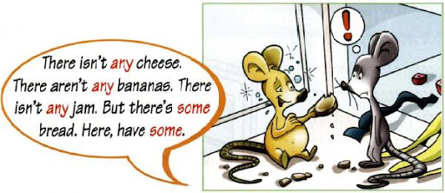
Izražanje količine
KP@2020

Slide 2
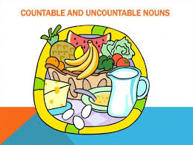
Countable or uncountable?
countable=števni
(one apple, two apples, three apples, …)
uncountable=neštevni
(bread, butter, milk, juice, meat, honey, jam, …)

Slide 3
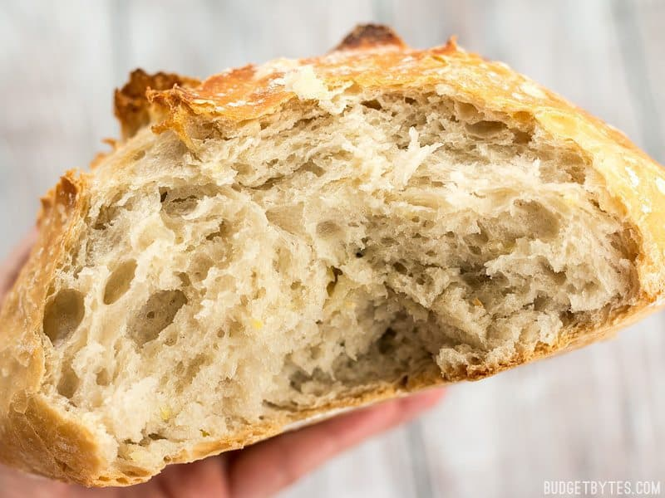
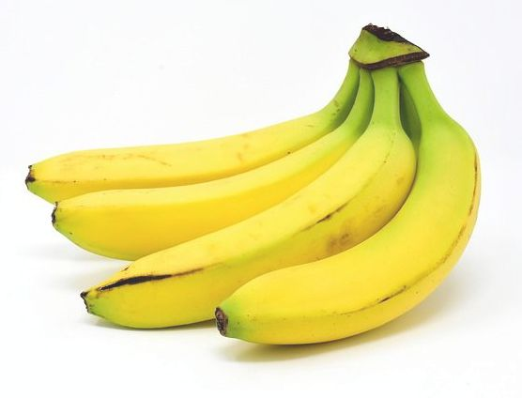
Some (nekaj)
We need some bread.
There are some bananas.

Slide 4
Any (nič, kaj)
We haven‘t got any juice.
There aren‘t any oranges.
Have we got any potatoes?
Are there any bananas?

Slide 5
Some or any?
some
-trdilne povedi: We have got some milk/peppers.
-vprašalne povedi, če vljudna prošnja ali ponudba:
Can I have some chocolate? (prošnja)
Would you like some milk? (ponudba)
any
-nikalne povedi: We haven‘t got any milk/peppers.
-vprašalne povedi: Have we got any milk/peppers?

Slide 6
Some, any or a/an?
a/an: pred števnimi v ednini
There is an apple and a banana.
some, any: - pred števnimi v množini
- pred neštevnimi samostalniki
There are some apples.
There‘s some bread.

Slide 7
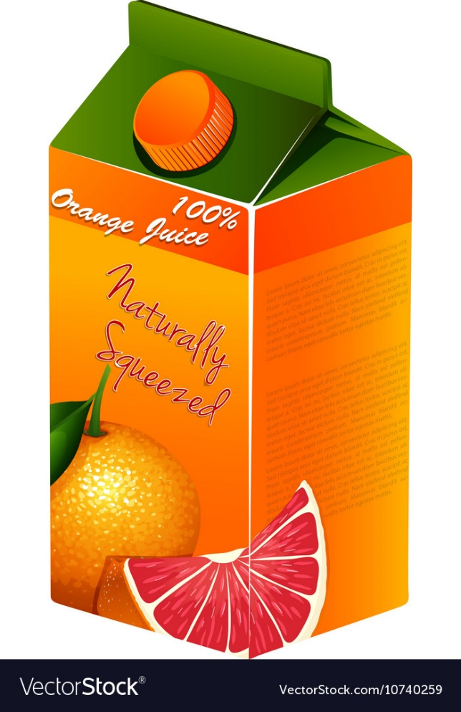
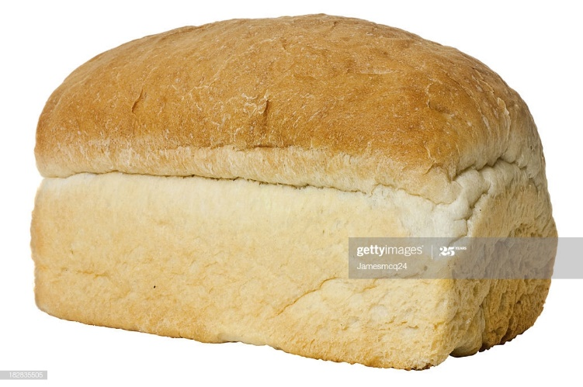
Posebni izrazi za količino
A loaf of bread
A bottle of water
A carton of milk/juice

Slide 8
How much or how many?
how much – z neštevnimi samostalniki
how many – s števnimi samostalniki
How much butter do we need?
How many lemons do we need?
How many loaves of bread do we need?
How many tins of beans shall we get?

Slide 9
Let‘s practise!
WE

